Slide 1

Line Breaking for Paragraph Formation
Team - DYNAMIC DUDES
Team - DYNAMIC DUDES
AIE19013
AIE19014
AIE19062
Charan Tej. K
Ch. Surya Teja
Sugash T.M

Slide 2
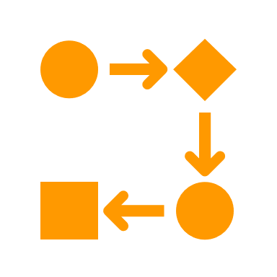






STEP 02
STEP 04
STEP 06
Dynamic Programming
Analysis
Sample Output
STEP 01
STEP 03
STEP 05
STEP 07
Introduction
Greedy Approach
Implementation
Conclusion

Slide 3


Introduction

Slide 4


Introduction
One of the most important operations necessary when text materials are prepared for printing or display is the task of dividing long paragraphs into individual lines
If the line breaking job is done poorly, readers will be distracted by bad breaks that interrupt their train of thought
In our project we are going to form a paragraph using long single lined text , so that the text is justified properly in a readable format

Slide 5
Introduction
Objectives:
Given an line of words and a width maxWidth, format the text such that each line has exactly maxWidth characters and is fully (left and right) justified.
We are going to pack as many words as we can in each line , confining the line’s length to the width provided in the input
Extra spaces between words will be distributed as evenly as possible. If the number of spaces on a line do not divide evenly between words,
We are going to use Dynamic Programming and Greedy approach in order to solve Text Justification Problem

Slide 6

Dynamic Programming

Slide 7
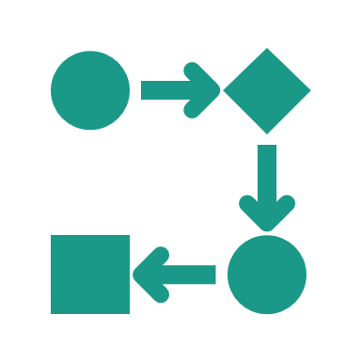
Dynamic Programming
Dynamic programming amounts to breaking down an optimization problem into simpler sub-problems, and storing the solution to each sub-problem so that each sub-problem is only solved once
In our program we are going to apply dynamic programming by breaking the sub problems as suffixes (remaining words in the list)
We are going to guess the list of words where to start the consecutive lines. Accordingly we apply recursive function which includes the penalty function for breaking the line. And finally we build our paragraph

Slide 8
Greedy Approach

Slide 9
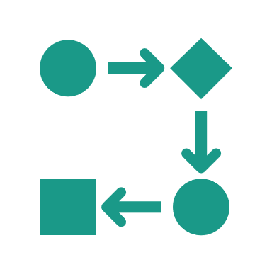
Greedy Approach
Greedy approach is an algorithmic strategy that makes the best optimal choice in the local group
Greedy algorithms work by recursively constructing a set of objects from the smallest possible constituent parts.
In our program we are going to apply greedy algorithm by straight away putting as much as possible words in the lines. However, this may not be the ideal solution to obtain an optimal result every time.

Slide 10

Analysis and Comparison

Slide 11

Analysis
Characteristics | Dynamic Programming | Greedy Approach
Feasibility | We make decision at each step considering current problem and solution to previously solved sub problem to calculate optimal solution | We make whatever choice seems best at the moment in the hope that it will lead to global optimal solution
Optimality | It is guaranteed that Dynamic Programming will generate an optimal solution | Sometimes there is no such guarantee of getting an optimal Solution
Time Complexity | Dynamic Programs are generally slower | Greedy programs are generally faster
Examples | Dijkstra's algorithm | Kruskal's Algorithm

Slide 12
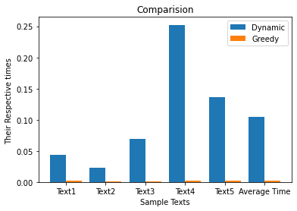
Comparison

Slide 13

Implementation

Slide 14

Implementation
Dynamic Programming
Analysis and Comparison
Text Beautification
$$1^{st}$$
$$2^{nd}$$
$$3^{rd}$$
$$4^{th}$$
$$5^{th}$$
Greedy Approach
GUI using PyQt5
14

Slide 15

Output

Slide 16

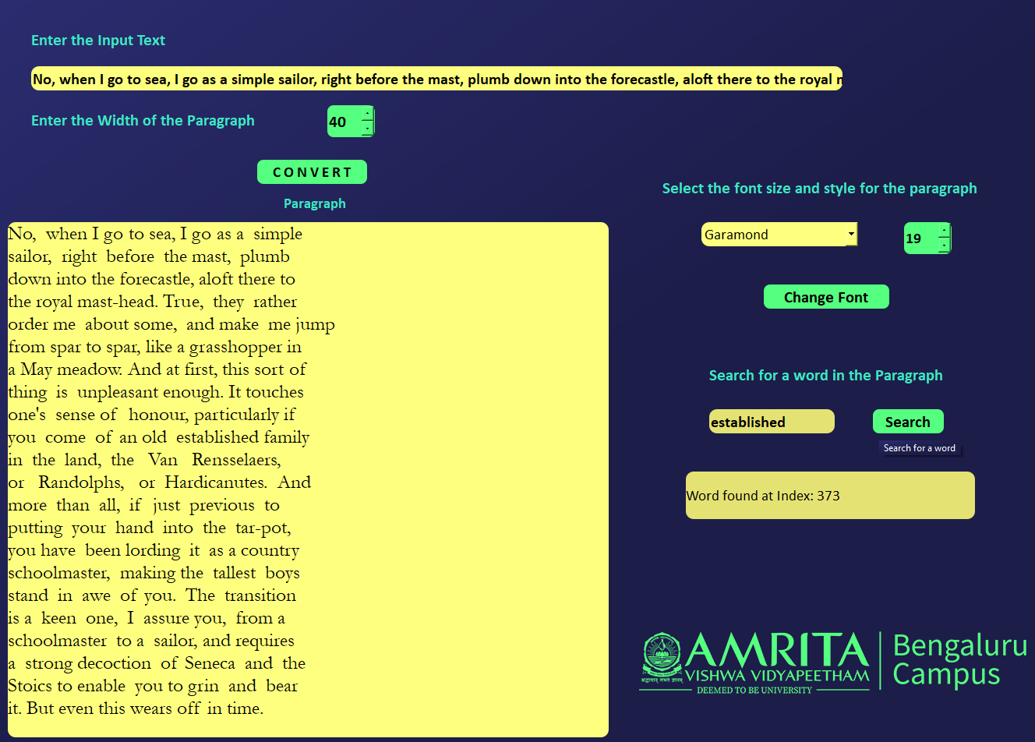
Output

Slide 17

Conclusion
To the best of our knowledge, we have explained about Dynamic Programming and greedy approach along with working principles, and have successfully implemented and executed them in our project.
Finally, we conclude by saying that we as a team understood the importance of algorithmic design techniques and their applications in tackling the real world problems.

Slide 18
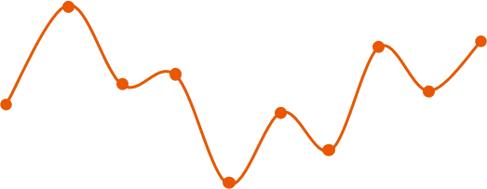
☺☺☺☺☺☺☺☺☺☺☺☺☺☺☺☺☺☺☺☺
Thank You
☺☺☺☺☺☺☺☺☺☺☺☺☺☺☺☺☺☺☺☺

